Slide 1




SUBJECT: PROGRAMMING IN JAVA
SEMESTER: 3rd Semester BCA
1
JAIN UNIVERSITY BCA

Slide 2
OBJECTS AND CLASSES
1
JAIN UNIVERSITY BCA

Slide 3



Java provides the concept of class to build objects.
A class defines the shape and working of an object.
It is the logical construct in which the entire Java language is built.

Slide 4




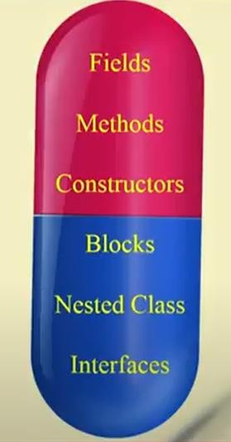
A class is a group of objects,
which have common properties.
It is a template / blueprint from
which objects are created.
It is a logical entity.
A class in java con contain:
Fields.
Methods.
Constructors.
Blocks.
Nested classes and interfaces.

Slide 5


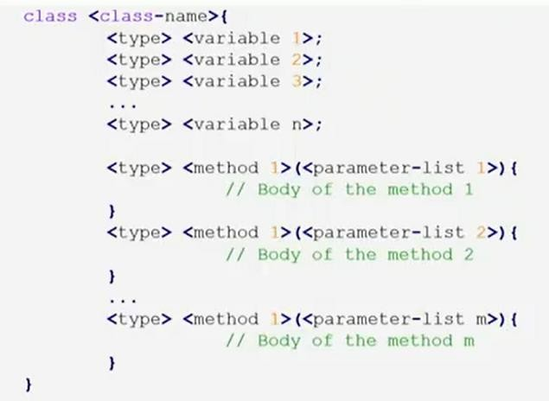

Slide 6








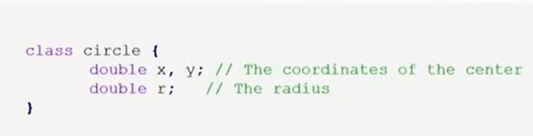
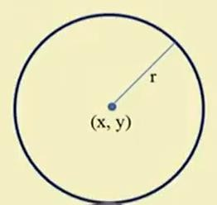





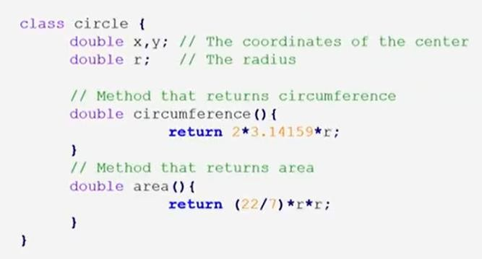

Slide 7






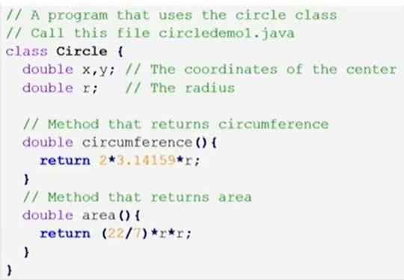
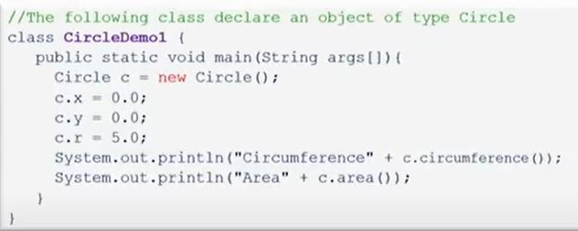

Slide 8

//the following class declares multiple objects ot type Circle
class CircleDemo
{
public static void main(String args[])
{
Circle c1 = new Circle();
Circle c2 = new Circle();
// Initialize the circles c1.x = 3.0;
c1.y = 4.0;
c1.r = 5.0;
c2.x = -4.0;
c2.y = -8.0;
c2.r = 10.0;
System.out.println("Circumference Circle 1" + c1.circumferrence()); System.out.println("Area Circle 1" + c1.area()); System.out.println("Circumference Circle 2" + c2.circumferrence()); System.out.println("Area Circle 2" + c2.area());
}
}

Slide 9

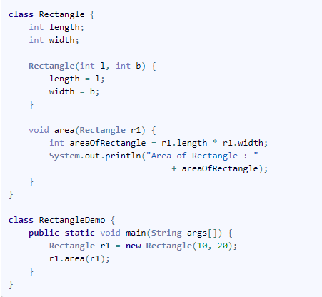

Slide 10


When we pass a primitive type to a method, it is passed by value.
But when we pass an object to a method, call-by-reference..
Changes to the object inside the method do reflect
in the object used as an argument.

Slide 11









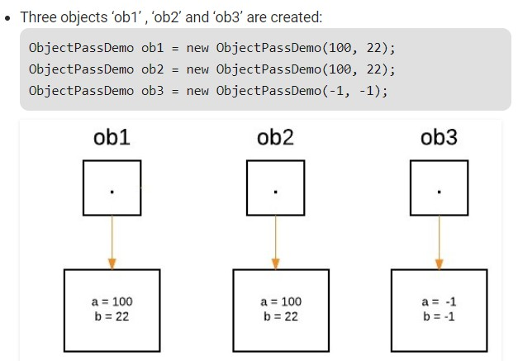
V R TY BC

Slide 12





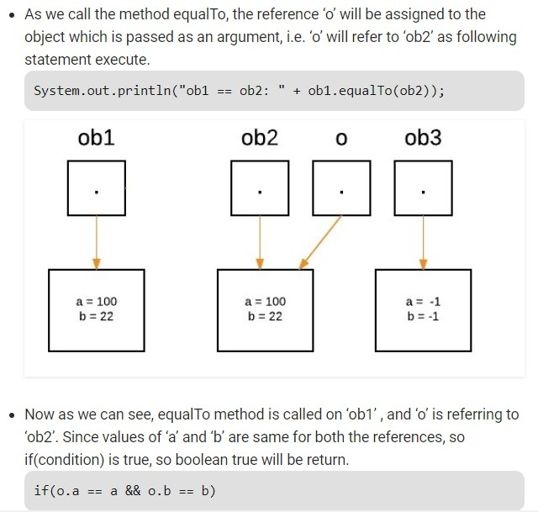
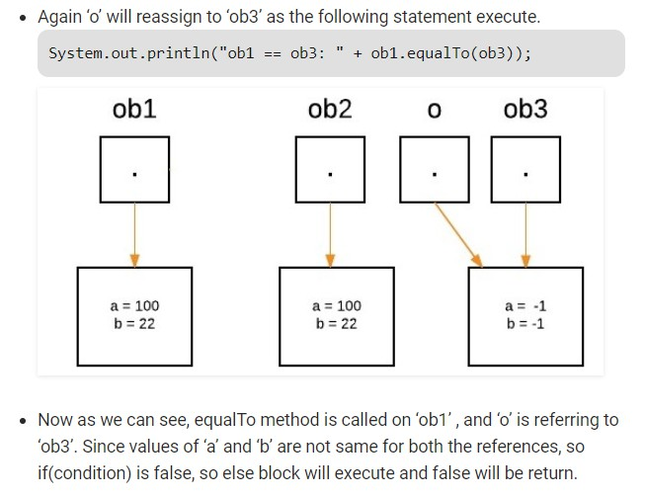
JAIN UNIVE SITY BC
29

Slide 13

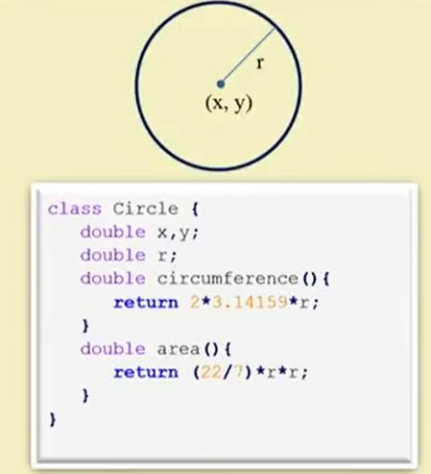
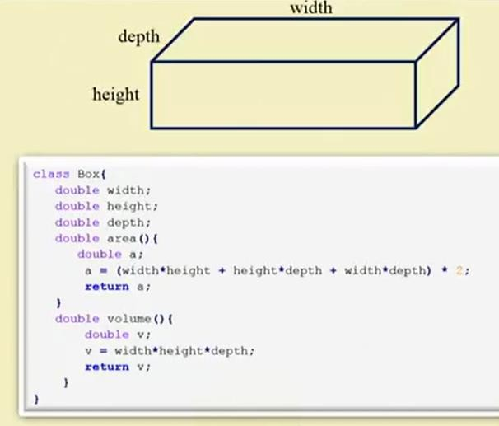

Slide 14



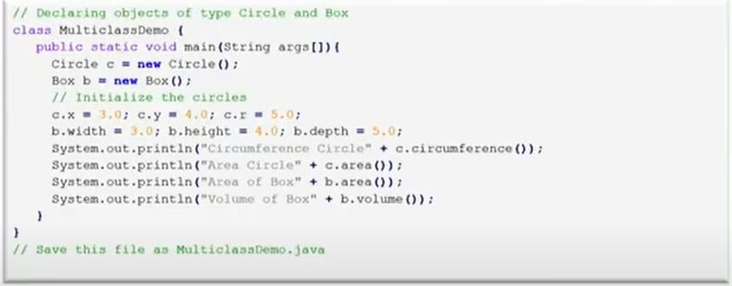

Slide 15


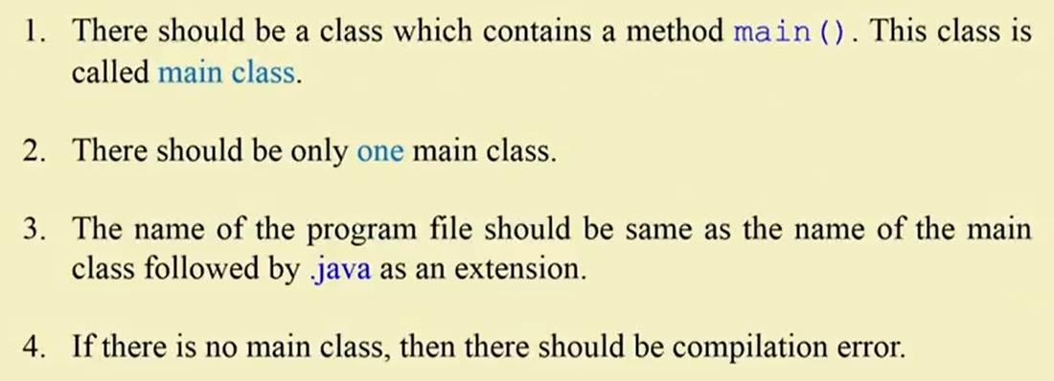
NOTE: Java program can not exist without main class

Slide 16

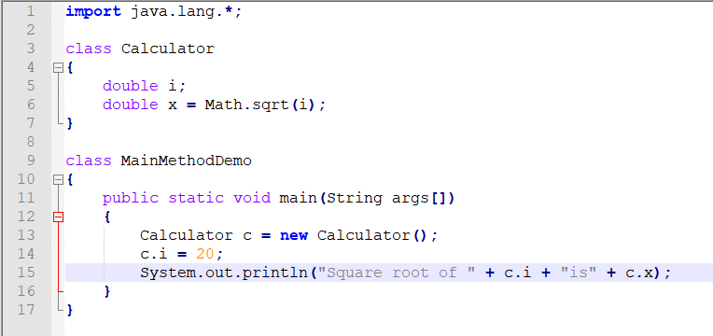
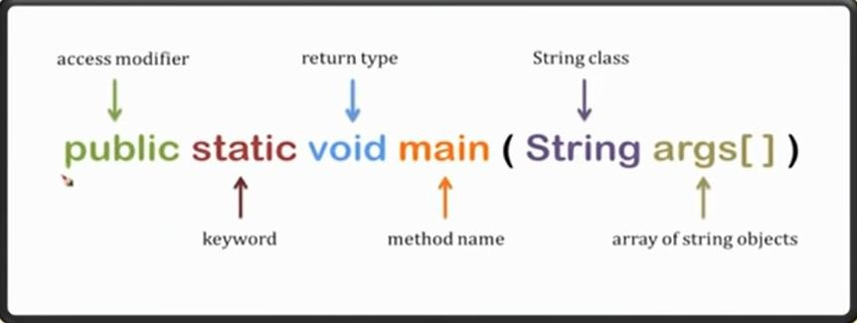
Java program starts its execution from a method belongs to main class only.

Slide 17

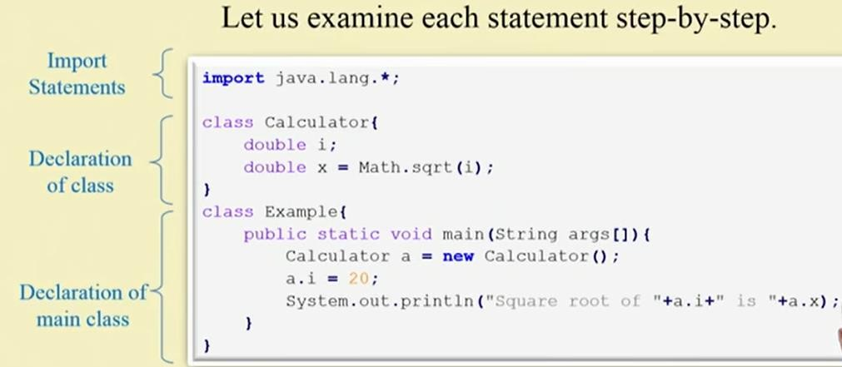

Slide 18

It serves as the entry point
It contains main method which is executed when the program run
It helps to organize and structure your code

Slide 19



public: It is an access specifier. We should use a public keyword before the main() method so that JVM can identify the execution point of the program. If we use private, protected, and default before the main() method, it will not be visible to JVM.
static: You can make a method static by using the keyword static. We should call the main() method without creating an object.
void: Void keyword acknowledges the compiler that main() method does not return any value.
main(): It is a default signature which is predefined in the JVM. It is called by JVM to execute a program line by line and end the execution after completion of this method.

Slide 20



String args[]: String is a class defined in java.lang API.
The main() method also accepts some data from the user. It accepts a group of strings, which is called a string array.
Here, agrs[] is the array name, and it is of String type. It means that it can store a group of string.
Values passed to the main() method is called arguments. These arguments are stored into args[] array, so the name args[] is generally used for it.

Slide 21

System is a final class from the java.lang package.
Out is a class variable of type PrintStream declared in the System class.
Println is a method of the PrintStream class.
a.i and a.x represents the names of variables to be printed.
⦿ + is a concatenation operator, it is used to concatenate the string values.

Slide 22

Println(): This text is passed as the parameter to this method in the form of String. The next printing takes place from next line
Print(): This text is passed as the parameter to this method in the form of String. This method prints the text on the console and the cursor remains at the end of the text at the console. The next printing takes place from just here.

Slide 23

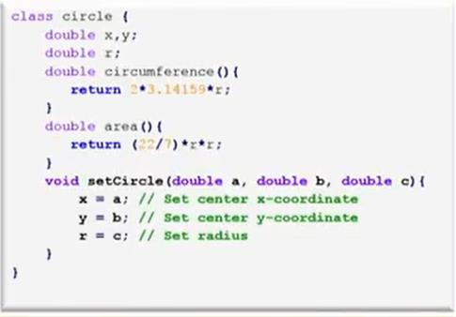
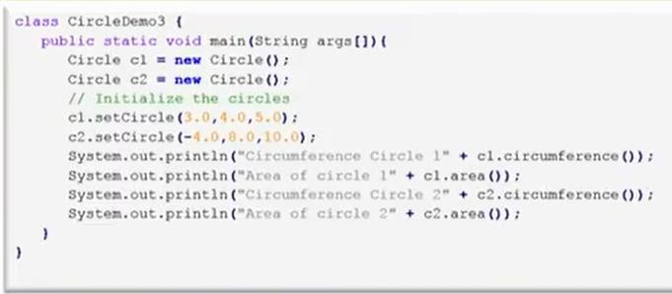

Slide 24
What is Constructor in Java?
Constructor is a special method that is used to initialize a newly created object and is called just after the memory is allocated for the object.
It can be used to initialize the objects to desired values or default values at the time of object creation.
Rules for creating a Java Constructor
It has the same name as the class
It should not return a value not even void

Slide 25




class Circle
{
double x,y;
double r;
double circumference()
{
return 2*3.14159*r;
}
double area()
{
return(22/7)*r*r;
}
Circle(double a, double b, double c)
{
x = a; y = b; r = c;
}
}

